Slide 1



Noida Institute of Engineering and Technology, Greater Noida
REINFORCEMENT LEARNING & CASE STUDIES
Unit: 5
MACHINE LEARNING
Ms.Alisha Sikri
Assistant Professor
AIML DEPARTMENT
B Tech 3RD Sem Section A & B

Slide 2

Brief Introduction of Faculty
I am pleased to introduce myself as Dr. Hitesh Singh, presently associated with NIET, Greater Noida as Assistant Professor in IT Department. I completed my Ph.D. degree under the supervision of Boncho Bonev (PhD), Technical University of Sofia, Sofia, Bulgaria in 2019. My area of research interest is related to Radio wave propagation, Machine Learning and have rich experience of millimetre wave technologies.
I started my research carrier in 2009 and since then I published research articles in SCI/Scopus indexed Journals/Conferences like Springer, IEEE, Elsevier. I presented research work in international reputed Conferences like (IEEE International Conference on Infocom Technologies and Unmanned Systems (ICTUS'2017)”, Dubai and ELECTRONICA, Sofia. Four patents and two book chapter have been published (Elsevier Publication) under my inventor ship and authorship.
My area of research interest is related to Radio wave propagation, Machine Learning and have rich experience of millimeter wave technologies.

Slide 3
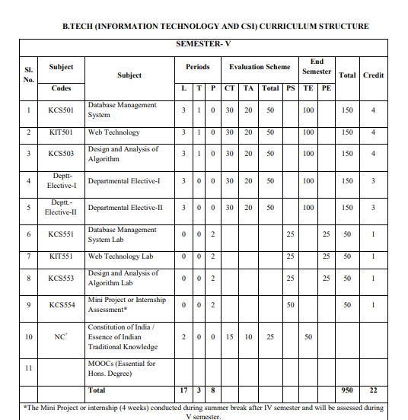
Evaluation Scheme

Slide 4
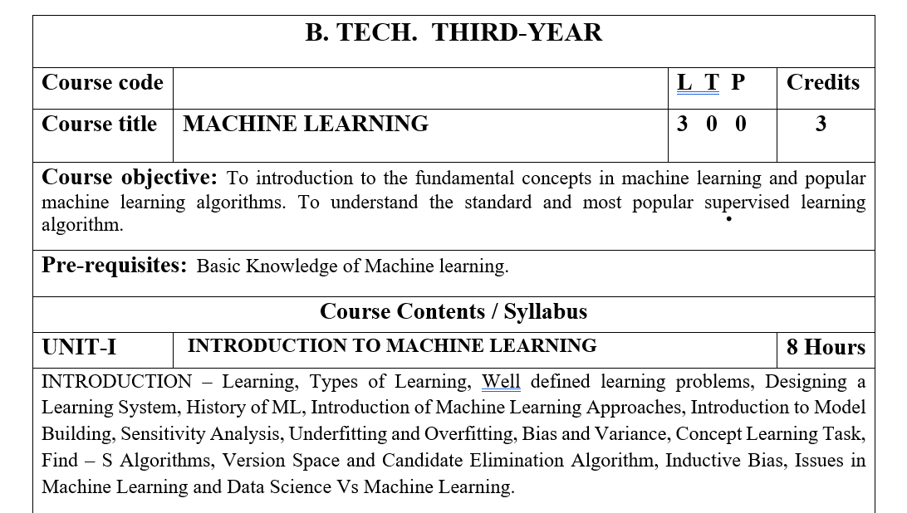
Subject Syllabus

Slide 5
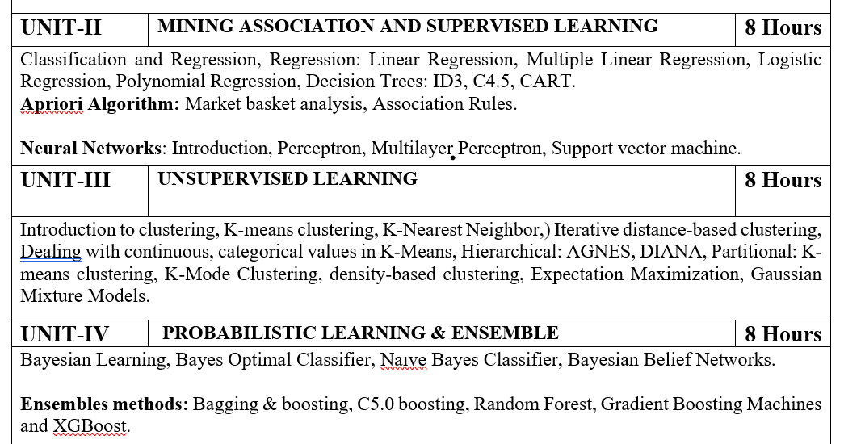
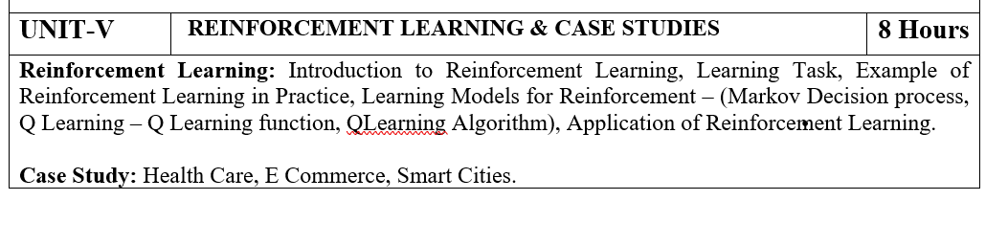
Subject Syllabus

Slide 6
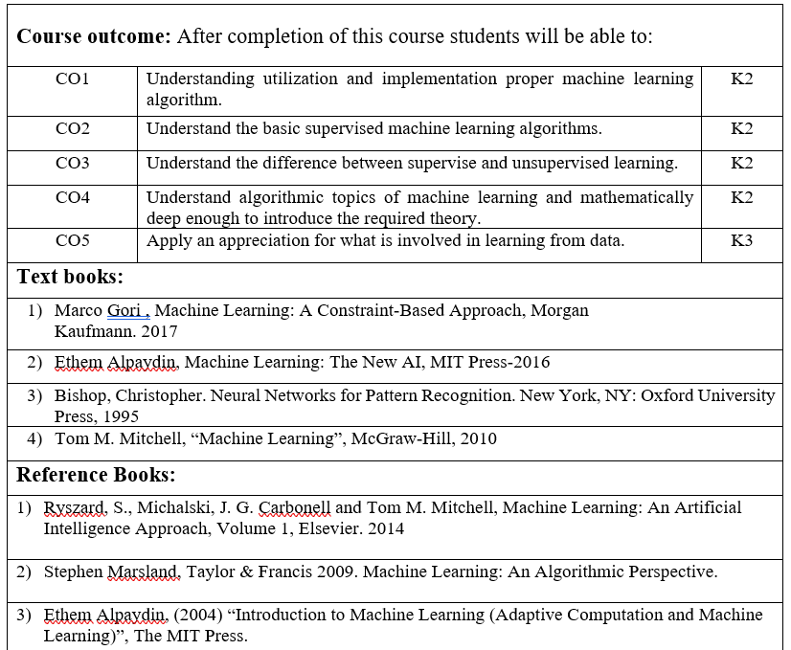
Text Books

Slide 7
Branch Wise Applications

Slide 8
Course Objective
To introduce students to the basic concepts of Machine Learning.
To develop skills of implementing machine learning for solving practical problems.
To gain experience of doing independent study and research related to Machine Learning

Slide 9
Course Outcome
At the end of the semester, student will be able to:
Course Outcomes (CO) | CO Description | Blooms’ Taxonomy
CO1 | Understanding utilization and implementation proper machine learning algorithm. | K2
CO2 | Understand the basic supervised machine learning algorithms. | K2
CO3 | Understand the difference between supervise and unsupervised learning. | K2
CO4 | Understand algorithmic topics of machine learning and mathematically deep enough to introduce the required theory. | K2
CO5 | Apply an appreciation for what is involved in learning from data. | K3

Slide 10
Program Outcome
1. Engineering knowledge:
2. Problem analysis:
3. Design/development of solutions:
4. Conduct investigations of complex problems:
5. Modern tool usage:
6. The engineer and society:
7. Environment and sustainability:
8. Ethics:
9. Individual and team work:
10. Communication:
11. Project management and finance:
12. Life-long learning

Slide 11
CO-PO and PSO Mapping
Correlation Matrix of CO with PO
CO.K | PO1 | PO2 | PO3 | PO4 | PO5 | PO6 | PO7 | PO8 | PO9 | PO10 | PO11 | PO12
KCS055.1 | 3 | 2 | 2 | 1 | 2 | 2 | - | - | - | 1 | - | -
KCS055.2 | 3 | 2 | 2 | 3 | 2 | 2 | 1 | - | 2 | 1 | 1 | 2
KCS055.3 | 2 | 2 | 2 | 2 | 2 | 2 | 2 | 1 | 1 | - | 1 | 3
KCS055.4 | 3 | 3 | 1 | 3 | 1 | 1 | 2 | - | 2 | 1 | 1 | 2
KCS055.5 | 3 | 2 | 1 | 2 | 1 | 2 | 1 | 1 | 2 | 1 | 1 | 1
AVG | 2.8 | 2.2 | 1.6 | 2.2 | 1.6 | 1.8 | 1.2 | 0.4 | 1.4 | 0.8 | 0.8 | 1.6

Slide 12
Program Specific Outcomes
PSO1: Work as a software developer, database administrator, tester or networking engineer for providing solutions to the real world and industrial problems.
PSO2:Apply core subjects of information technology related to data structure and algorithm, software engineering, web technology, operating system, database and networking to solve complex IT problems.
PSO3: Practice multi-disciplinary and modern computing techniques by lifelong learning to establish innovative career.
PSO4: Work in a team or individual to manage projects with ethical concern to be a successful employee or employer in IT industry.

Slide 13
CO-PO and PSO Mapping
Matrix of CO/PSO:
 | PSO1 | PSO2 | PSO3 | PSO4
RCS080.1 | 3 | 2 | 3 | 1
RCS080.2 | 3 | 2 | 2 | 3
RCS080.3 | 3 | 2 | 3 | 2
RCS080.4 | 2 | 1 | 1 | 1
RCS080.5 | 2 | 2 | 1 | 2
AVG | 2.6 | 1.8 | 2 | 1.8

Slide 14
Program Educational Objectives
PEO1: able to apply sound knowledge in the field of information technology to fulfill the needs of IT industry.
PEO2:able to design innovative and interdisciplinary systems through latest digital technologies.
PEO3: able to inculcate professional and social ethics, team work and leadership for serving the society.
PEO4: able to inculcate lifelong learning in the field of computing for successful career in organizations and R&D sectors.

Slide 15
Result Analysis
ML Result of 2020-21: 89.39%
Average Marks: 46.05

Slide 16
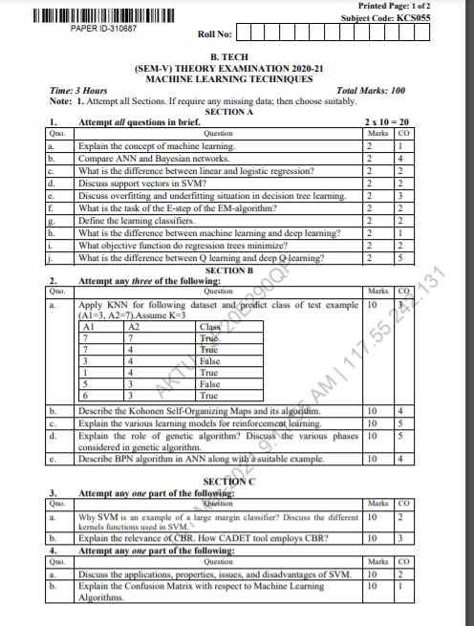
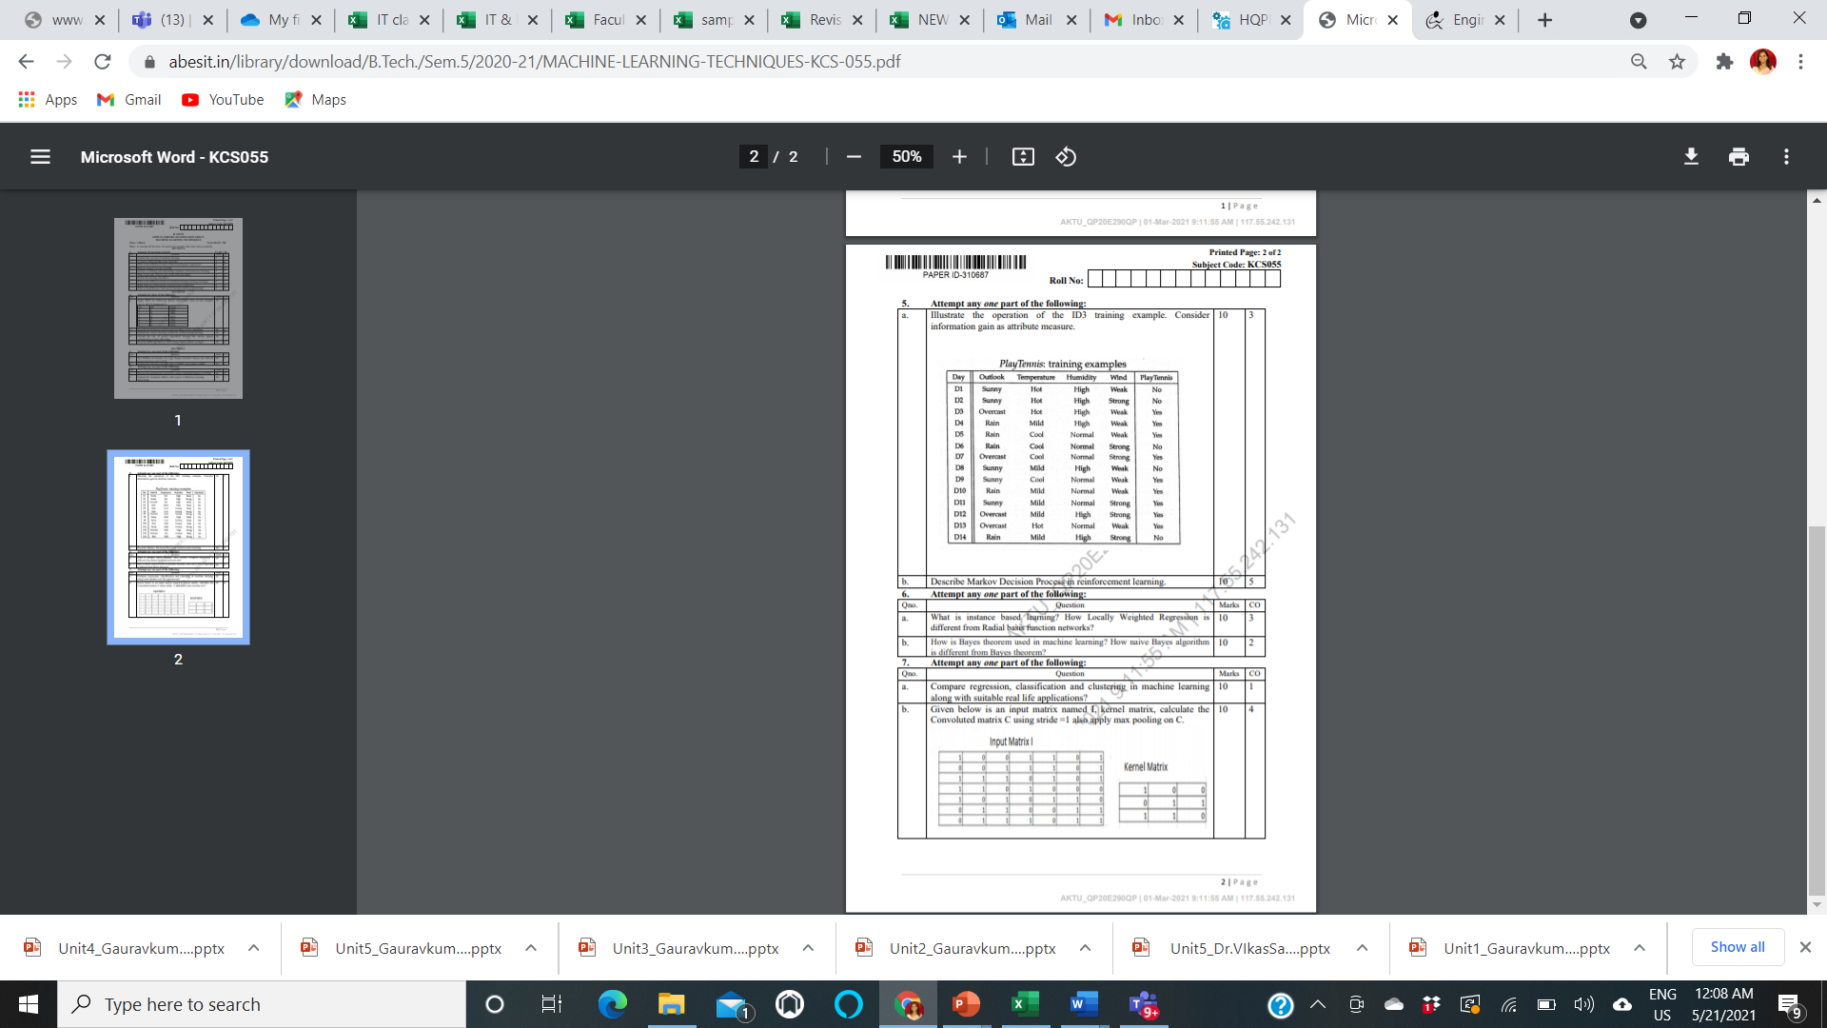
End Semester Question Paper Template

Slide 17
Prerequisite
Prerequisites:
Statistics.
Linear Algebra.
Calculus.
Probability.
Programming Languages.

Slide 18
Brief Introduction to Subject
https://www.youtube.com/watch?v=PPLop4L2eGk&list=PLLssT5z_DsK-h9vYZkQkYNWcItqhlRJLN

Slide 19
Topic Mapping with Course Outcome
Topics | Course outcome
Reinforcement Learning: Introduction to Reinforcement Learning, Learning Task, Example of Reinforcement Learning in Practice, Learning Models for Reinforcement – (Markov Decision process, Q Learning – Q Learning function, QLearning Algorithm), Application of Reinforcement Learning. | CO5 CO5 CO5 CO5 CO5 CO5

Slide 20
Lecture Plan

Slide 21
Lecture Plan

Slide 22
Lecture Plan

Slide 23
Lecture Plan

Slide 24
Lecture Plan

Slide 25
Unit 5 Content:
Reinforcement Learning: Introduction to Reinforcement Learning,
Learning Task,
Example of Reinforcement Learning in Practice,
Learning Models for Reinforcement – (Markov Decision process,
Q Learning – Q Learning function, QLearning Algorithm),
Application of Reinforcement Learning.

Slide 26
Unit Objective
The objective of the Unit 1 is
1. To understand the basics of Reinforcement learning,
2. A clear concept of Reinforcement Learning and Reinforcement learning systems
3. To understand Q learning Algorithm.
4. To understand Hidden Marchove Model.

Slide 27
Topic Objective
Student will be able to understand
Introduction to Reinforcement Learning,
Learning Task,
Example of Reinforcement Learning in Practice,
Learning Models for Reinforcement – (Markov Decision process, Q Learning – Q Learning function,
Q Learning Algorithm),
Application of Reinforcement Learning.

Slide 28
Topic Objective
Student will be able to understand
Basics of Reinforcement Learning

Slide 29
Reinforcement Learning (CO1,2,3,5)
Reinforcement Learning is defined as a Machine Learning method that is concerned with how software agents should take actions in an environment.
Reinforcement Learning is a part of the deep learning method that helps you to maximize some portion of the cumulative reward.
Dr. Hitesh Singh KCS 055 ML Unit 5

Slide 30
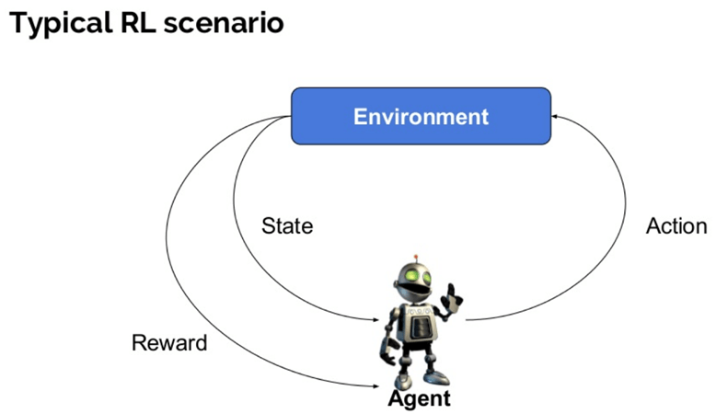
Reinforcement Learning (CO1,2,3,5)
AGENT = PEAS ( Performance, Environment, Actuator, Sensor)
Dr. Hitesh Singh KCS 055 ML Unit 5

Slide 31
Reinforcement Learning (CO1,2,3,5)
Agent: It is an assumed entity which performs actions in an environment to gain some reward.
Environment (e): A scenario that an agent has to face.
Reward (R): An immediate return given to an agent when he or she performs specific action or task.
State (s): State refers to the current situation returned by the environment.
Policy (π): It is a strategy which applies by the agent to decide the next action based on the current state.
Value (V): It is expected long-term return with discount, as compared to the short-term reward.
Value Function: It specifies the value of a state that is the total amount of reward. It is an agent which should be expected beginning from that state.
Model of the environment: This mimics the behavior of the environment. It helps you to make inferences to be made and also determine how the environment will behave.
Model based methods: It is a method for solving reinforcement learning problems which use model-based methods.
Q value or action value (Q): Q value is quite similar to value. The only difference between the two is that it takes an additional parameter as a current action.
Dr. Hitesh Singh KCS 055 ML Unit 5

Slide 32
Reinforcement Learning (CO1,2,3,5)
How Reinforcement Learning works?
Let's see some simple example which helps you to illustrate the reinforcement learning mechanism.
Consider the scenario of teaching new tricks to your cat
As cat doesn't understand English or any other human language, we can't tell her directly what to do. Instead, we follow a different strategy.
We emulate a situation, and the cat tries to respond in many different ways.
If the cat's response is the desired way, we will give her fish.
Now whenever the cat is exposed to the same situation, the cat executes a similar action with even more enthusiastically in expectation of getting more reward(food).
That's like learning that cat gets from "what to do" from positive experiences.
At the same time, the cat also learns what not do when faced with negative experiences.
Dr. Hitesh Singh KCS 055 ML Unit 5

Slide 33
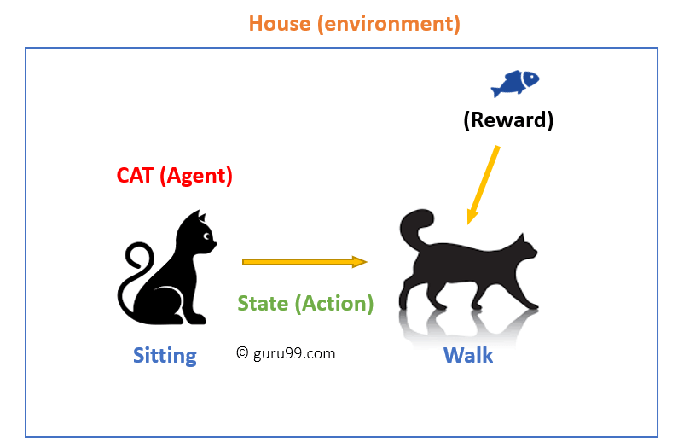
Reinforcement Learning (CO1,2,3,5)
Dr. Hitesh Singh KCS 055 ML Unit 5

Slide 34
Reinforcement Learning (CO1,2,3,5)
In this case,
Your cat is an agent that is exposed to the environment.
In this case, it is your house.
An example of a state could be your cat sitting, and you use a specific word in for cat to walk.
Our agent reacts by performing an action transition from one "state" to another "state."
For example, your cat goes from sitting to walking.
The reaction of an agent is an action, and the policy is a method of selecting an action given a state in expectation of better outcomes.
After the transition, they may get a reward or penalty in return.
Dr. Hitesh Singh KCS 055 ML Unit 5

Slide 35
Reinforcement Learning (CO1,2,3,5)
Reinforcement Learning Algorithms:
There are three approaches to implement a Reinforcement Learning algorithm.
Value function-Based:
In a value-based Reinforcement Learning method, you should try to maximize a value function V(s). In this method, the agent is expecting a long-term return of the current states under policy π.
Policy-based:
In a policy-based RL method, you try to come up with such a policy that the action performed in every state helps you to gain maximum reward in the future.
Dr. Hitesh Singh KCS 055 ML Unit 5

Slide 36
Reinforcement Learning (CO1,2,3,5)
Two types of policy-based methods are:
Deterministic: For any state, the same action is produced by the policy π.
Stochastic: Every action has a certain probability, which is determined by the following equation. Stochastic Policy :
n{a\s) = P\A, = a\S, =S]
Model-Based:
In this Reinforcement Learning method, you need to create a virtual model for each environment. The agent learns to perform in that specific environment.
Dr. Hitesh Singh KCS 055 ML Unit 5

Slide 37
Reinforcement Learning (CO1,2,3,5)
Characteristics of Reinforcement Learning:
Here are important characteristics of reinforcement learning.
There is no supervisor, only a real number or reward signal.
Sequential decision making.
Time plays a crucial role in Reinforcement problems.
Feedback is always delayed, not instantaneous.
Agent's actions determine the subsequent data it receives.
Dr. Hitesh Singh KCS 055 ML Unit 5

Slide 38
Reinforcement Learning (CO1,2,3,5)
Types of Reinforcement Learning
Two kinds of reinforcement learning methods are:
Positive:
It is defined as an event, that occurs because of specific behavior. It increases the strength and the frequency of the behavior and impacts positively on the action taken by the agent.
This type of Reinforcement helps you to maximize performance and sustain change for a more extended period. However, too much Reinforcement may lead to over-optimization of state, which can affect the results.
Negative:
Negative Reinforcement is defined as strengthening of behavior that occurs because of a negative condition which should have stopped or avoided. It helps you to define the minimum stand of performance. However, the drawback of this method is that it provides enough to meet up the minimum behavior.
Dr. Hitesh Singh KCS 055 ML Unit 5

Slide 39
Reinforcement Learning (CO1,2,3,5)
Learning Models of Reinforcement
There are two important learning models in reinforcement learning:
Markov Decision Process
Q learning
Dr. Hitesh Singh KCS 055 ML Unit 5

Slide 40
Reinforcement Learning (CO1,2,3,5)
Markov Decision Process
A Markov Decision Process (MDP) model contains:
A set of possible world states S.
A set of Models.
A set of possible actions A.
A real valued reward function R(s,a).
A policy the solution of Markov Decision Process.
Dr. Hitesh Singh KCS 055 ML Unit 5

Slide 41
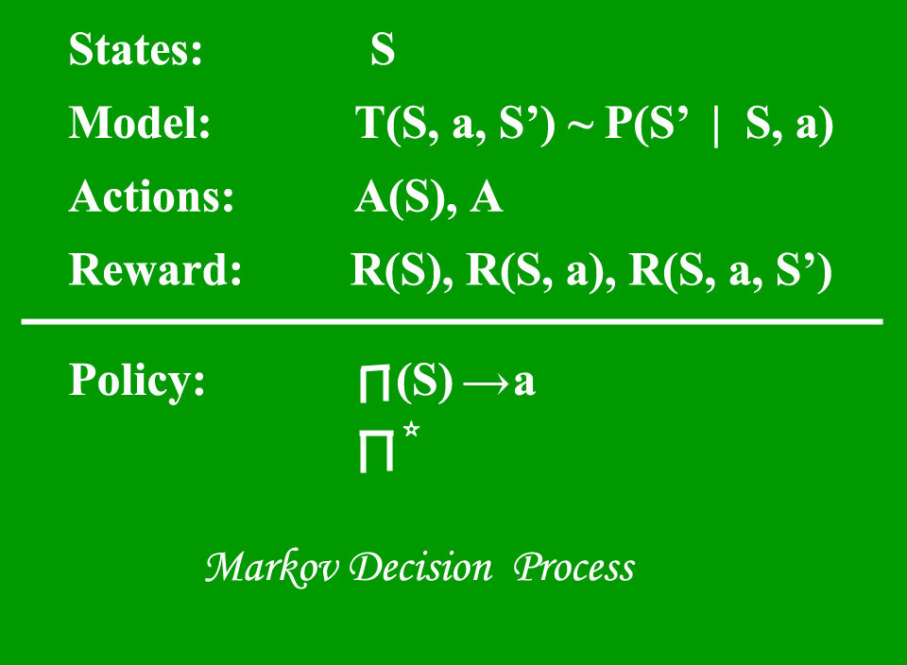
Reinforcement Learning (CO1,2,3,5)
Dr. Hitesh Singh KCS 055 ML Unit 5

Slide 42
Reinforcement Learning (CO1,2,3,5)
What is a State?
A State is a set of tokens that represent every state that the agent can be in.
What is a Model?
A Model (sometimes called Transition Model) gives an action’s effect in a state.
In particular, T(S, a, S’) defines a transition T where being in state S and taking an action ‘a’ takes us to state S’ (S and S’ may be same).
For stochastic actions (noisy, non-deterministic) we also define a probability P(S’|S,a) which represents the probability of reaching a state S’ if action ‘a’ is taken in state S.
Note Markov property states that the effects of an action taken in a state depend only on that state and not on the prior history.
Dr. Hitesh Singh KCS 055 ML Unit 5

Slide 43
Reinforcement Learning (CO1,2,3,5)
What is Actions?
An Action A is set of all possible actions. A(s) defines the set of actions that can be taken being in state S.
What is a Reward?
A Reward is a real-valued reward function. R(s) indicates the reward for simply being in the state S. R(S,a) indicates the reward for being in a state S and taking an action ‘a’. R(S,a,S’) indicates the reward for being in a state S, taking an action ‘a’ and ending up in a state S’.
What is a Policy?
A Policy is a solution to the Markov Decision Process. A policy is a mapping from S to a. It indicates the action ‘a’ to be taken while in state S.
Dr. Hitesh Singh KCS 055 ML Unit 5

Slide 44
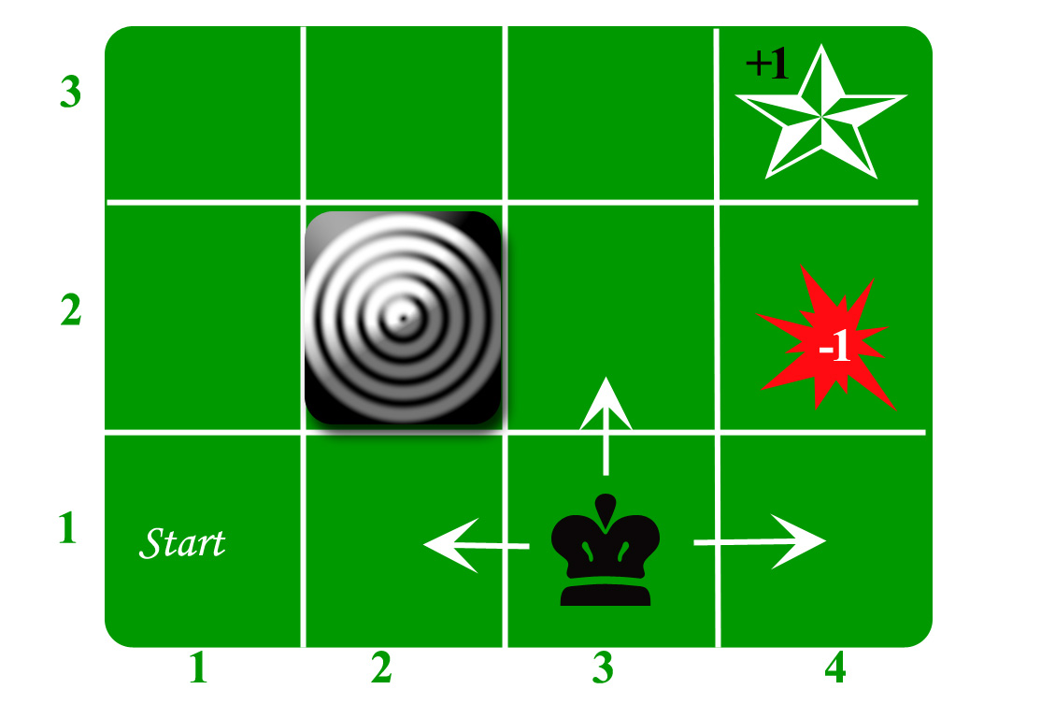
Reinforcement Learning (CO1,2,3,5)
Dr. Hitesh Singh KCS 055 ML Unit 5

Slide 45
Reinforcement Learning (CO1,2,3,5)
An agent lives in the grid. The above example is a 3*4 grid. The grid has a START state(grid no 1,1).
The purpose of the agent is to wander around the grid to finally reach the Blue Diamond (grid no 4,3).
Under all circumstances, the agent should avoid the Fire grid (orange color, grid no 4,2).
Also the grid no 2,2 is a blocked grid, it acts like a wall hence the agent cannot enter it.
The agent can take any one of these actions: UP, DOWN, LEFT, RIGHT
Walls block the agent path, i.e., if there is a wall in the direction the agent would have taken, the agent stays in the same place.
So for example, if the agent says LEFT in the START grid he would stay put in the START grid.
Dr. Hitesh Singh KCS 055 ML Unit 5

Slide 46
Reinforcement Learning (CO1,2,3,5)
First Aim: To find the shortest sequence getting from START to the Diamond. Two such sequences can be found:
RIGHT RIGHT UP UP RIGHT
UP UP RIGHT RIGHT RIGHT
Let us take the second one (UP UP RIGHT RIGHT RIGHT) for the subsequent discussion.
The move is now noisy.
80% of the time the intended action works correctly.
20% of the time the action agent takes causes it to move at right angles.
For example, if the agent says UP the probability of going UP is 0.8 whereas the probability of going LEFT is 0.1 and probability of going RIGHT is 0.1 (since LEFT and RIGHT is right angles to UP).
Dr. Hitesh Singh KCS 055 ML Unit 5

Slide 47
Reinforcement Learning (CO1,2,3,5)
The agent receives rewards each time step:-
Small reward each step (can be negative when can also be term as punishment, in the above example entering the Fire can have a reward of -1).
Big rewards come at the end (good or bad).
The goal is to Maximize sum of rewards.
Dr. Hitesh Singh KCS 055 ML Unit 5

Slide 48
Reinforcement Learning (CO1,2,3,5)
There are two popular Learning approaches
1. Policy Based-
In this learning approach, a policy i.e. a function mapping each state to the best action is optimized. Once we have a well-defined policy, the agent can determine the best action to take by giving the current state as an input to the policy.
We can further divide the policies in two types-
Deterministic – A policy at a given state returns a unique action
S=(s) ➡ A= (a)
Stochastic – Instead of returning a unique action, it returns a probability distribution of actions at a given state.
Policy ➡ p (A = a | S = s)
2. Value Based-
In value-based RL, the objective is to optimize a value function, a function (can be thought of as a simple Lookup table) which maps maximum future reward to a given state. The value of each state is the total amount of reward an RL agent can expect to receive until the fulfilment of goal.
Dr. Hitesh Singh KCS 055 ML Unit 5

Slide 49
Reinforcement Learning (CO1,2,3,5)
Q Learning
Q Learning comes under Value-based learning algorithms.
The objective is to optimize a value function suited to a given problem/environment.
The ‘Q’ stands for quality; it helps in finding the next action resulting in a state of the highest quality.
This approach is rather simple and intuitive.
It a very good place to start the RL journey.
The values are stored in a table, called a Q Table.
Dr. Hitesh Singh KCS 055 ML Unit 5

Slide 50
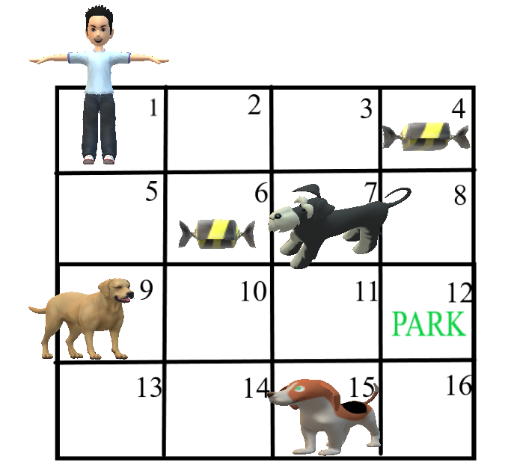
Reinforcement Learning (CO1,2,3,5)
Let us devise a simple 2D game environment of size 4 x 4 and understand how Q- Learning can be used to arrive at the best solution.
Dr. Hitesh Singh KCS 055 ML Unit 5

Slide 51
Reinforcement Learning (CO1,2,3,5)
Goal: Guide the kid to the Park
Reward System: A. Get candy = +10 points B. Encounter Dog = -50 points C. Reach Park = +50 points
End of an Episode: A. Encounter Dog B. Reach Park
Dr. Hitesh Singh KCS 055 ML Unit 5

Slide 52
Reinforcement Learning (CO1,2,3,5)
Now let us see how a typical Q learning agent will play this game.
First, let us create a Q- table where we will keep a track of all values associated with each state.
The Q Table will have rows equal to the number of states in the problem i.e. 16 in our case, and the number of columns would be equal to the number of actions an agent can make which happens to be 4 (Up, Down, Left & Right).
Dr. Hitesh Singh KCS 055 ML Unit 5

Slide 53
Reinforcement Learning (CO1,2,3,5)
ACTIONS STATES | UP | DOWN | LEFT | RIGHT
1 (START) | 0 | 0 | 0 | 0
2 | 0 | 0 | 0 | 0
…… | 0 | 0 | 0 | 0
16 | 0 | 0 | 0 | 0
Dr. Hitesh Singh KCS 055 ML Unit 5

Slide 54
Reinforcement Learning (CO1,2,3,5)
Learning Process
Step 1: Initialization
When the agent plays the game for the first time, it has no prior knowledge so let’s initialize the table with zeroes.
Step 2: Exploitation OR Exploration
Now the agent can interact with the environment in two ways: either it can use already gained info from the Q-table i.e. exploit, or it can venture to uncharted territories i.e. explore.
Exploitation becomes very useful when the agent has worked out a high number of episodes and has information about the environment.
Whereas, the exploration becomes important when the agent is naïve and does not have much experience.
This tradeoff between exploitation and exploration can be handled by including epsilon in the value function.
Ideally, at initial stages, we would like to give more preference to exploration, while in the later stages exploitation would be more useful.
In Step 2, the agent takes an action (exploit or explore).
Dr. Hitesh Singh KCS 055 ML Unit 5

Slide 55
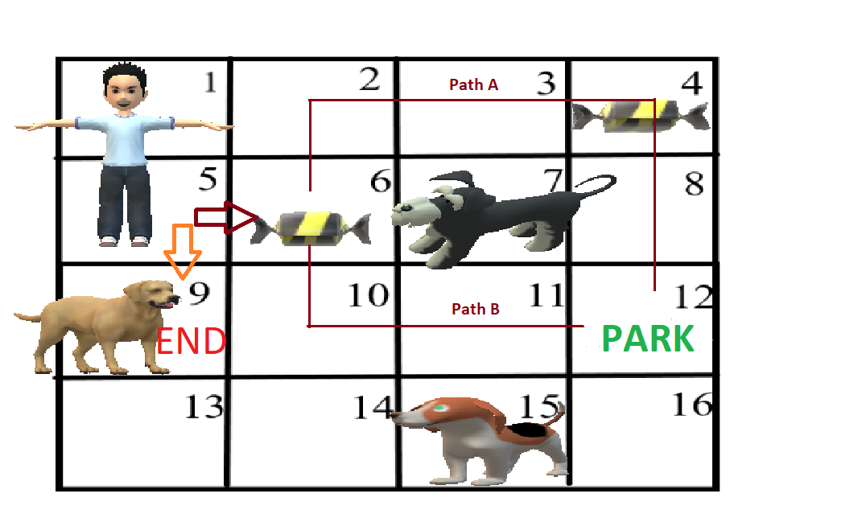
Reinforcement Learning (CO1,2,3,5)
Step 3: Measure Reward
After the agent performs an action decided in step 2, it reaches the next state say s’. Now again at state s’ the four actions can be performed, each one leading to a different reward score.
Dr. Hitesh Singh KCS 055 ML Unit 5

Slide 56
Reinforcement Learning (CO1,2,3,5)
For e.g, the boy moves from 1 to 5, now either 6 can be selected or 9 can be selected.
Now for finding the reward value for state 5, we will find out the reward values of all the future states i.e, 6 & 9, and select the maximum value.
At 5, there are two options (For simplicity retracing steps is not performed)–
Go to 9 : End of Episode
Go to 6 : At state 6 there are again 3 options –
Go to 7 – End of Episode
Go to 2 – Continue this step until reach end of episode and find out the reward
Go to 10 – Continue this step, find out reward
Dr. Hitesh Singh KCS 055 ML Unit 5

Slide 57
Reinforcement Learning (CO1,2,3,5)
Sample Calculation
Path A reward = 10 + 50 = 60
Path B reward = 50
Max Reward = 60 (Path A)
Total Rewards at State 5: -50 (Faced dog at 9), 10 + 60 (Max reward from State 6 onwards)
Value of reward at 5 = Max (-50 , 10+60 ) = 70
Dr. Hitesh Singh KCS 055 ML Unit 5

Slide 58
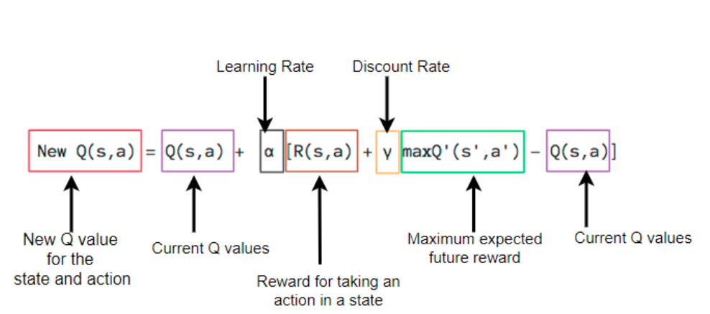
Reinforcement Learning (CO1,2,3,5)
Step 4: Update the Q table
The reward value calculated in step 3 is then used to update the value at state 5 using the Bellman’s equation-
Dr. Hitesh Singh KCS 055 ML Unit 5

Slide 59
Reinforcement Learning (CO1,2,3,5)
Here, Learning rate = A constant which determines how much weightage you want to give to the new value vs the old value.
Discount Rate = Constant that discounts the effect of future rewards (0.8 to 0.99), i.e., balance the effect of future rewards in the new values.
The agent will iterate over these steps and achieve a Q- Table with updated values.
Now using this Q-Table is as simple as using a map, for each state select an action, which leads to a state with the maximum Q value.
Dr. Hitesh Singh KCS 055 ML Unit 5

Slide 60
Reinforcement Learning (CO1,2,3,5)
Reinforcement Learning vs. Supervised Learning
Parameters | Reinforcement Learning | Supervised Learning
Decision style | reinforcement learning helps you to take your decisions sequentially. | In this method, a decision is made on the input given at the beginning.
Works on | Works on interacting with the environment. | Works on examples or given sample data.
Dependency on decision | In RL method learning decision is dependent. Therefore, you should give labels to all the dependent decisions. | Supervised learning the decisions which are independent of each other, so labels are given for every decision.
Best suited | Supports and work better in AI, where human interaction is prevalent. | It is mostly operated with an interactive software system or applications.
Example | Chess game | Object recognition
Dr. Hitesh Singh KCS 055 ML Unit 5

Slide 61
Reinforcement Learning (CO1,2,3,5)
Applications of Reinforcement Learning
Here are applications of Reinforcement Learning:
Robotics for industrial automation.
Business strategy planning
Machine learning and data processing
It helps you to create training systems that provide custom instruction and materials according to the requirement of students.
Aircraft control and robot motion control
Dr. Hitesh Singh KCS 055 ML Unit 5

Slide 62
Reinforcement Learning (CO1,2,3,5)
Why use Reinforcement Learning?
Here are prime reasons for using Reinforcement Learning:
It helps you to find which situation needs an action
Helps you to discover which action yields the highest reward over the longer period.
Reinforcement Learning also provides the learning agent with a reward function.
It also allows it to figure out the best method for obtaining large rewards.
When Not to Use Reinforcement Learning?
You can't apply reinforcement learning model is all the situation. Here are some conditions when you should not use reinforcement learning model.
When you have enough data to solve the problem with a supervised learning method
You need to remember that Reinforcement Learning is computing-heavy and time-consuming. in particular when the action space is large.
Dr. Hitesh Singh KCS 055 ML Unit 5

Slide 63
Reinforcement Learning (CO1,2,3,5)
Challenges of Reinforcement Learning
Here are the major challenges you will face while doing Reinforcement earning:
Feature/reward design which should be very involved
Parameters may affect the speed of learning.
Realistic environments can have partial observability.
Too much Reinforcement may lead to an overload of states which can diminish the results.
Realistic environments can be non-stationary.
Dr. Hitesh Singh KCS 055 ML Unit 5

Slide 64
Assignment 1:
What is Reinforcement Learning? How does it compare with other ML techniques?
How to define States in Reinforcement Learning?
Name some approaches or algorithms you know in to solve a problem in Reinforcement Learning
Provide an intuitive explanation of what is a Policy in Reinforcement learning
What are the steps involved in a typical Reinforcement Learning algorithm?
Dr. Hitesh Singh KCS 055 ML Unit 1

Slide 65
Daily Quiz
1. Which of the following is not Advantages of reinforcement learning?
A) Maximizes Performance
B) Sustain Change for a long period of time
C) Too much Reinforcement can lead to overload of states which can diminish the results
D) None of these
ANSWER= C) Too much Reinforcement can lead to overload of states which can diminish the results
2. Reinforcement learning is one of ______ basic machine learning paradigms
A) 5
B) 4
C) 2
D) 3
ANSWER= D) 3

Slide 66
Daily Quiz
3. ________is a type of Machine Learning paradigms in which a learning algorithm is trained not on preset data but rather based on a feedback system.
A) Supervised learning
B) Unsupervised learning
C) Reinforcement Learning
D) None of the above
ANSWER= C) Reinforcement Learning
4. There are _______ types of reinforcement.
A) 3
B) 2
C) 4
D) None of these
ANSWER= B) 2
Explain:- there are 2 types of reinforcement which are positive and negative

Slide 67
Glossary Questions
1._______ is an area of Machine Learning in which about taking suitable action to maximize reward in a particular situation.
A) Supervised learning
B) unsupervised learning
C) Reinforcement learning
D) None of these
ANSWER= C) Reinforcement learning
Explain:-Reinforcement learning is an area of Machine Learning. It is about taking suitable action to maximize reward in a particular situation.
2._______is all about making decisions sequentially
A) Supervised learning
B) unsupervised learning
C) Reinforcement learning
D) None of these
ANSWER= C) Reinforcement learning
Explain:- Reinforcement learning is all about making decisions sequentially.

Slide 68
Glossary Questions
3.In_________ output depends on the state of the current input and the next input depends on the output of the previous input.
A) Supervised learning
B) unsupervised learning
C) Reinforcement learning
D) None of these
ANSWER= C) Reinforcement learning
Explain:-In Reinforcement learning the output depends on the state of the current input and the next input depends on the output of the previous input
4._________Reinforcement is defined as when an event, occurs due to a particular behavior.
A) negetive
B) positive
C) neutral
D) None of these
ANSWER= B) positive

Slide 69
MCQ
1. Reinforcement learning is-
A. Unsupervised learning
B. Supervised learning
C. Award based learning
D. None
2. Which of the following is an application of reinforcement learning?
A. Topic modeling
B. Recommendation system
C. Pattern recognition
D. Image classification

Slide 70
MCQ
3. Upper confidence bound is a
A. Reinforcement algorithm
B. Supervised algorithm
C. Unsupervised algorithm
D. None
4. Which of the following is true about reinforcement learning?
A. The agent gets rewards or penalty according to the action
B. It’s an online learning
C. The target of an agent is to maximize the rewards
D. All of the above

Slide 71
Faculty Video Links, Youtube & NPTEL Video Links and Online Courses Details
Youtube video-
https://www.youtube.com/watch?v=PDYfCkLY_DE
https://www.youtube.com/watch?v=ncOirIPHTOw
https://www.youtube.com/watch?v=cW03t3aZkmE

Slide 72
Weekly Assignment
Q1: What is Reinforcement Learning? How does it compare with other ML techniques?
Q2: What is Markov Decision Process?
Q3: Provide an intuitive explanation of what is a Policy in Reinforcement learning
Q4: What is the role of the Discount Factor in Reinforcement Learning?
Q5: Name some approaches or algorithms you know in to solve a problem in Reinforcement Learning
Q6: How to define States in Reinforcement Learning?
Q7: What is the difference between a Reward and a Value for a given State?
Q8: How do you know when a Q-Learning Algorithm converges?

Slide 73
Old Question Papers
Note: No old question paper available for this subject. Introduced first time.
I have added expected question for university exam in next slide.

Slide 74
Expected Questions for University Exam
1. What is Reinforcement Learning? How does it compare with other ML techniques?
2. How to formulate a basic Reinforcement Learning problem?
3. What are some of the most used Reinforcement Learning algorithms?
4. What are the practical applications of Reinforcement Learning?
5. How can I get started with Reinforcement Learning?

Slide 75
References
Text books:
1. Tom M. Mitchell, ―Machine Learning, McGraw-Hill Education (India) Private Limited, 2013.
2. Ethem Alpaydin, ―Introduction to Machine Learning (Adaptive Computation and Machine Learning), The MIT Press 2004.
3. Stephen Marsland, ―Machine Learning: An Algorithmic Perspective, CRC Press, 2009.
4. Bishop, C., Pattern Recognition and Machine Learning. Berlin: Springer-Verlag.

Slide 76
Recap of Unit
Reinforcement Learning addresses the problem of learning control strategies for autonomous agents with least or no data. RL algorithms are powerful in machine learning as collecting and labelling a large set of sample patterns cost more than data itself.

Slide 77
INTRODUCTION
Thank you

